Slide 1

Open Source at Enterprise Scale
Jeremy Justus, Ross Sbriscia
Optum Technology
Notes:
R
There is no Open Source without a Community.

Slide 2
Jeremy Justus Sr Software Engineer
Seeker of StackOverflows
Kong Champion
Ross Sbriscia Sr Software Engineer
Expert Googler Kong Champion
Notes:
S
Need new pictures!

Slide 3

Healthcare Space 300,000 Employees Thousands of APIs Fortune Six Company
Optum Technology
Optum provides the tech infrastructure for UnitedHealth Group
Notes:
R
OPTUM LEGAL – PHOTO SOURCE: https://www.unitedhealthgroup.com/newsroom/media-library.html
Make a joke about not being Fortune 5 anymore?

Slide 4
Starting Point
Closed-Source Gateway Solution
Primary Gateway Solution for 3 years
Stability Issues
Scalability/Performance Issues
Low Supportability
High Operating Costs
API Gateway Space, Late 2017
The Gateway Solution
Notes:
R

Slide 5

Optum’s Modernization Movement
Invest in Open Source!
An organizational change in mindset, as both a top-down and bottom-up initiative.
Supported By
Engineers
Architects
Legal
Security
Sr. Executives
Notes:
R

Slide 6


Gateway Selection Criteria
Open Source vs Proprietary
Avoid vendor lock
Licensing management/cost
Extensibility
Stateless vs Stateful
Ease of scale and replication
Automated build and deployments
Decreased recovery time
Federated DevOps model
Performance
Asynchronous routing
Resource efficiency
Higher throughput
Notes:
R
https://www.geograph.ie/photo/5107100
https://commons.wikimedia.org/wiki/File:Warrington_town_hall.jpg
Both Public Use Creative Commons licensed.

Slide 7
Setting the Stage
0
Path to Kong in production
Notes:
S

Slide 8

Legal & Security
Security Requirements
Supplemented Kong with a WAF solution to meet internal security standards for the API GW layer
Open Source Approval
Due to efforts made during the modernization movement, this was easy!
Improved Routing
Negotiated a security policy change to eliminate two gateway-hop routing flow
Notes:
J
https://pixabay.com/photos/cyber-law-legal-internet-gavel-3328371/
https://pixabay.com/service/license/
Free for commercial use No attribution required

Slide 9
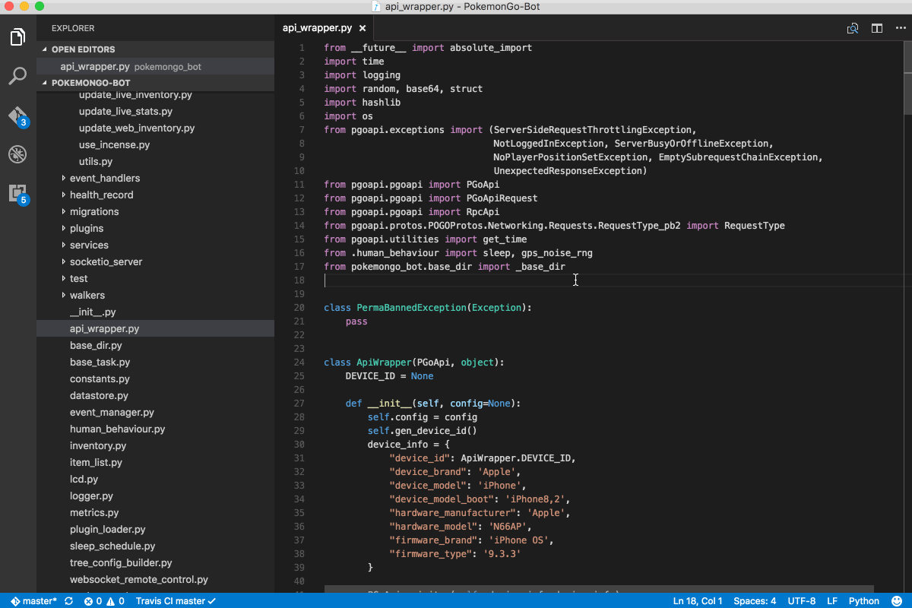
Initial Tunings
Shared OAuth Token Creation URL
Created a pattern which utilizes the shared-credentials option for all OAuth Client-Credentials protected proxies, with a common Token Creation endpoint
Nginx Modifications
Persistent Connections
Socket Timeouts
Buffers
Worker Processes
TCP settings
SSL Settings
and more…
Notes:
J
WIKI COMMONS IMAGE https://upload.wikimedia.org/wikipedia/commons/6/6b/General6545.gif

Slide 10
Supporting Open Source
“How can we, as a large enterprise, have confidence in Open Source products?”
Notes:
R
When we announced that we had chosen to vet Kong, as our first candidate technology, we had a lot of questions from within the Company about supportability
What would we do in an emergency?
What would we do if a release didn’t work?
Effectively – “title” – . Today, we’re going to try and answer that question from our own experience.

Slide 11
Cultivate Internal Experts
1
Take the expertise from the Open Source community, and make it work for you
Notes:
R
[ spiel ] – Understand this model not only matches the vendor-provided model, but significantly 1-ups it. To see why, let’s quickly look at the vendor-model

Slide 12
Vendor-Provided Model
Experts are “rented”, and expertise is rendered only on specific requests
- Experts can only react, not innovate
Experts are unfamiliar with the specific environmental conditions
- Can significantly increase time to restoration, and reduce overall efficacy during troubleshooting
Product is opaque, and your team’s understanding of it is limited
- Severely hampers internal innovation around the solution
Notes:
Make sure

Slide 13
Open-Source Model
Experts have the opportunity to leverage their skills for the benefit your entire space
- Experts can optimize integrations, support and ops because of this understanding
Experts are fully versed in the specific environmental conditions
- Can significantly decrease MTT, and maximize overall efficacy during troubleshooting
Product is entirely visible, and your team’s understanding of it is fully unhindered
- Enables cultivated experts to do full fledged solutioning
Notes:
R
OPTUM LEGAL: Photo Source - https://hub.uhg.com/sites/hub/Resources/Brand/UnitedHealth-Group-Brand/ImagesBusiness/Forms/DispForm.aspx?ID=29&Source=https%3A%2F%2Fhub%2Euhg%2Ecom%2Fsites%2Fhub%2FResources%2FBrand%2FUnitedHealth%2DGroup%2DBrand%2FImagesBusiness%2FForms%2FThumbnails%2Easpx&ContentTypeId=0x01010200D08BDA4379D60F46BD30D259A66B22C6
Clear and Easy path to Open-Source Contributions
Open-Source Development Practices
Due to these factors,
Top-Down & Bottom-Up movement
Legal, EIS, Sr Exec, Engineers, Architects

Slide 14
How do we cultivate Internal experts?
Notes:
R
Which brings me to our second idea -

Slide 15
Community Participation
2
Tried but True
Notes:
R
This gets thrown around so often it’s understandable to consider it in the same vein as somany overused memes, but truely embracing this idea is absolutely necessary to benefit from the virtuous cycle of open-source. There’s no 50/50 here. To do Open Source right, you need to jump in head first.

Slide 16

Any issues with Kong today?
No, why?
We just started to receive some HTTP 502s during our testing… and can’t find logs for the transactions
Notes:
R

Slide 17
Any issues with Kong today?
No, why?
We just started to receive some HTTP 502s during our testing… and can’t find logs for the transactions
Found the transaction in our STDOUT…
Notes:
R

Slide 18
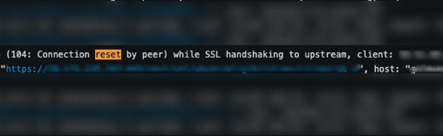
No, why?
We just started to receive some HTTP 502s during our testing… and can’t find logs for the transactions
Found the transaction in our STDOUT…
Notes:
R

Slide 19
Found the transaction in our STDOUT…
Looks like we got a connection reset on this transactions
Notes:
R

Slide 20
Found the transaction in our STDOUT…
Looks like we got a connection reset on this transactions
But that doesn’t explain why we’re missing a log even for this…
Notes:
R

Slide 21
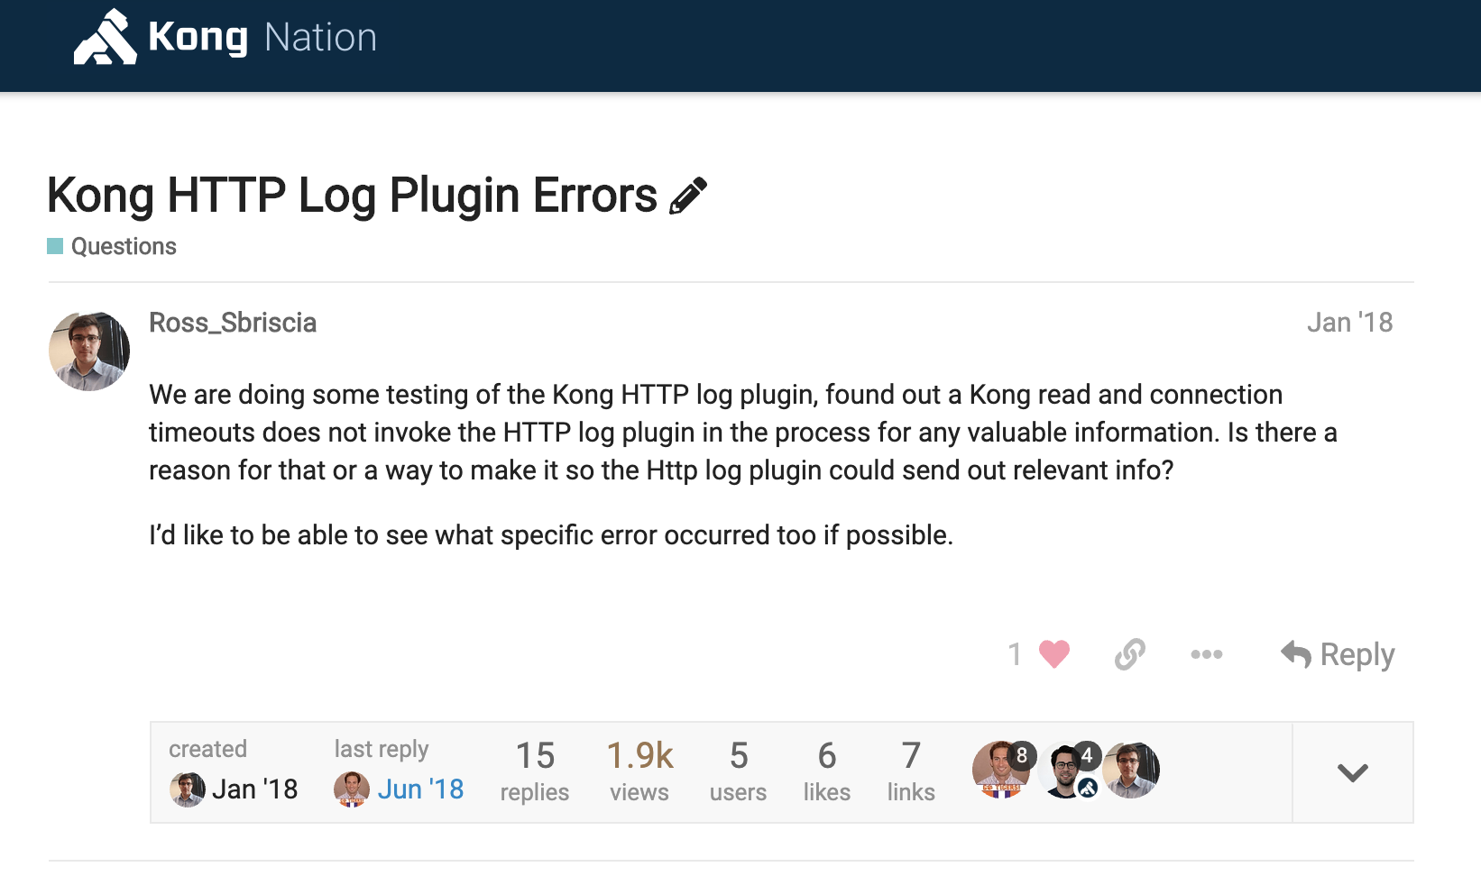
Notes:
R

Slide 22
On layer-4 errors, the Kong HTTP Log plugin doesn’t log transaction. Any idea why?
Try invoking the kong.log() method in the kong_error_handler block?
Notes:
R
https://discuss.konghq.com/t/kong-http-log-plugin-errors/445
https://discuss.konghq.com/t/kong-http-log-plugin-errors/445/3

Slide 23
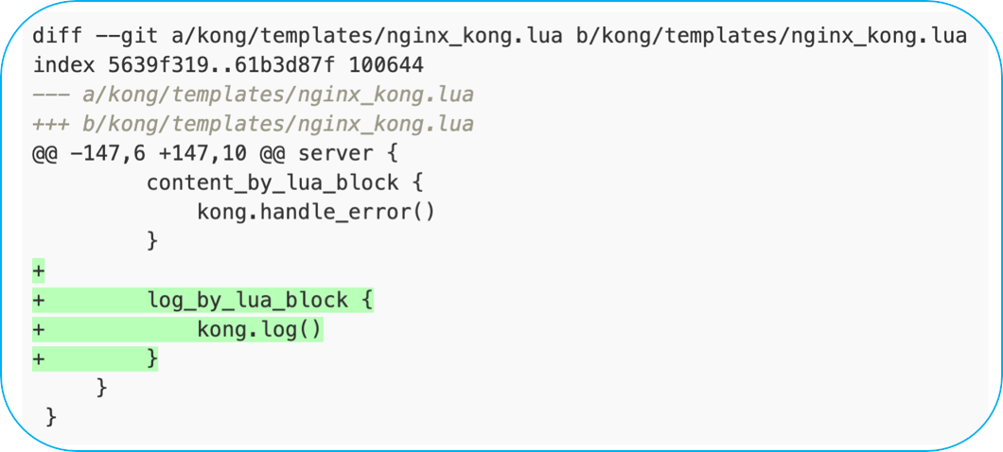
On layer-4 errors, the Kong HTTP Log plugin doesn’t log transaction. Any idea why?
Try invoking the kong.log() method in the kong_error_handler block?
Notes:
R
https://discuss.konghq.com/t/kong-http-log-plugin-errors/445
https://discuss.konghq.com/t/kong-http-log-plugin-errors/445/3

Slide 24
Notes:
R

Slide 25
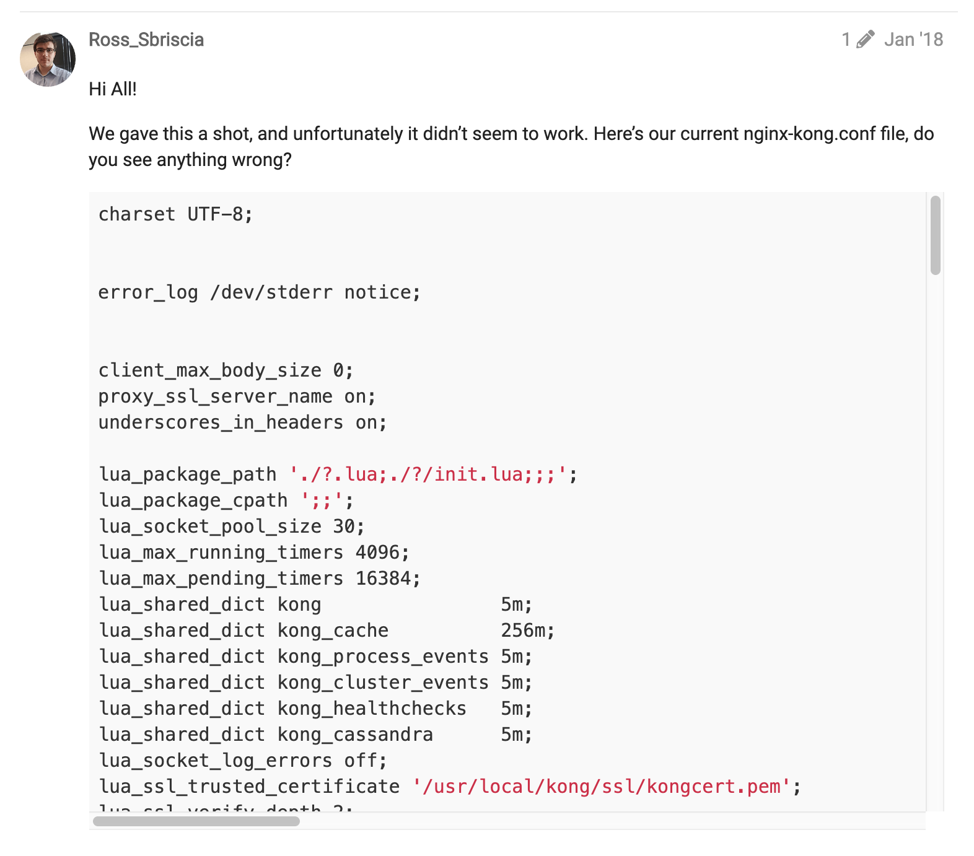
Notes:
R
https://discuss.konghq.com/t/kong-http-log-plugin-errors/445
https://discuss.konghq.com/t/kong-http-log-plugin-errors/445/3

Slide 26
On layer-4 errors, the Kong HTTP Log plugin doesn’t log transaction. Any idea why?
Try invoking the kong.log() method in the kong_error_handler block?
Didn’t work!
Notes:
R
https://discuss.konghq.com/t/kong-http-log-plugin-errors/445
https://discuss.konghq.com/t/kong-http-log-plugin-errors/445/3

Slide 27
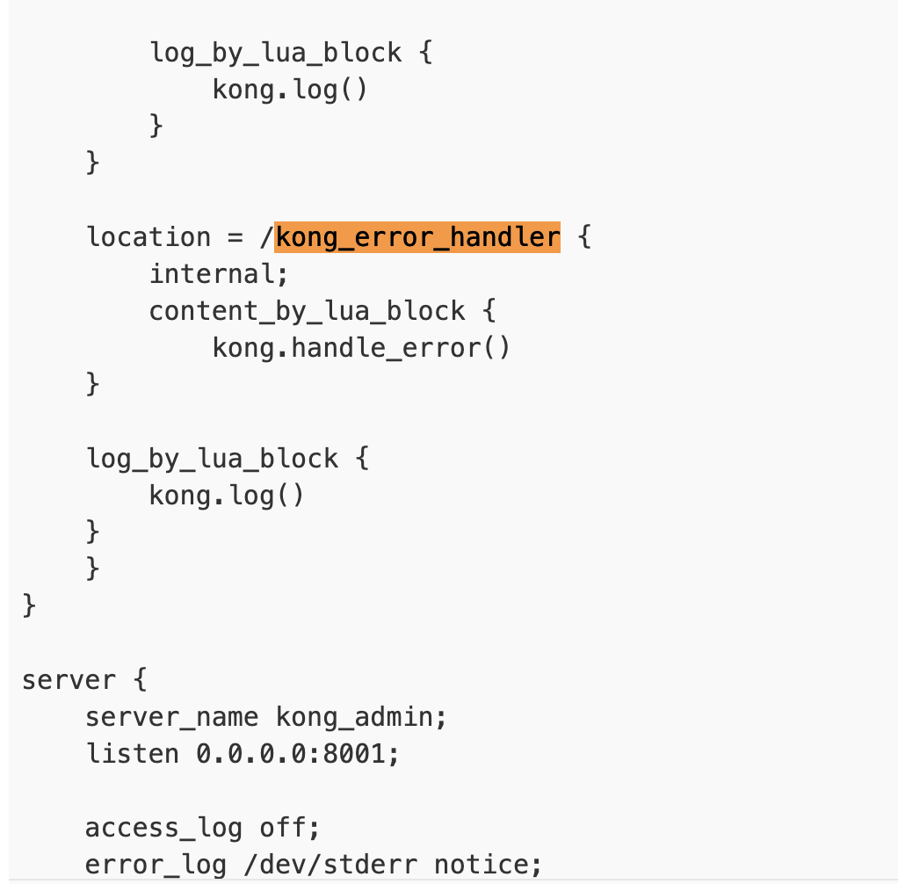
Try invoking the kong.log() method in the kong_error_handler block?
Didn’t work!
Notes:
R
https://discuss.konghq.com/t/kong-http-log-plugin-errors/445
https://discuss.konghq.com/t/kong-http-log-plugin-errors/445/3

Slide 28
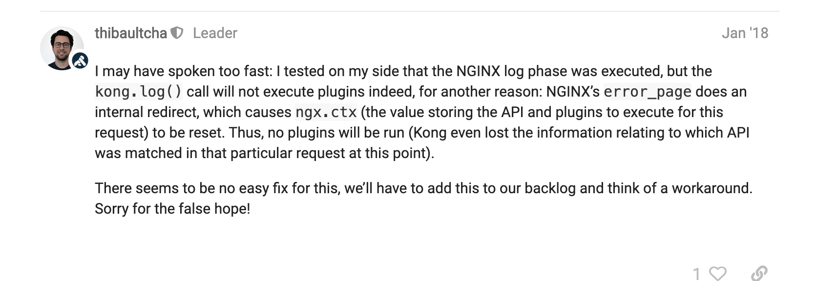
Notes:
R
https://discuss.konghq.com/t/kong-http-log-plugin-errors/445
https://discuss.konghq.com/t/kong-http-log-plugin-errors/445/3

Slide 29
Hmm…
Nginx’s error_page does an internal redirect which resets ngx.ctx… thus, no plugin will be run
Notes:
R
https://discuss.konghq.com/t/kong-http-log-plugin-errors/445
https://discuss.konghq.com/t/kong-http-log-plugin-errors/445/3

Slide 30

Hmm…
Nginx’s error_page does an internal redirect which resets ngx.ctx… thus, no plugin will be run
We’ll take a look
Notes:
R
https://discuss.konghq.com/t/kong-http-log-plugin-errors/445
https://discuss.konghq.com/t/kong-http-log-plugin-errors/445/3

Slide 31
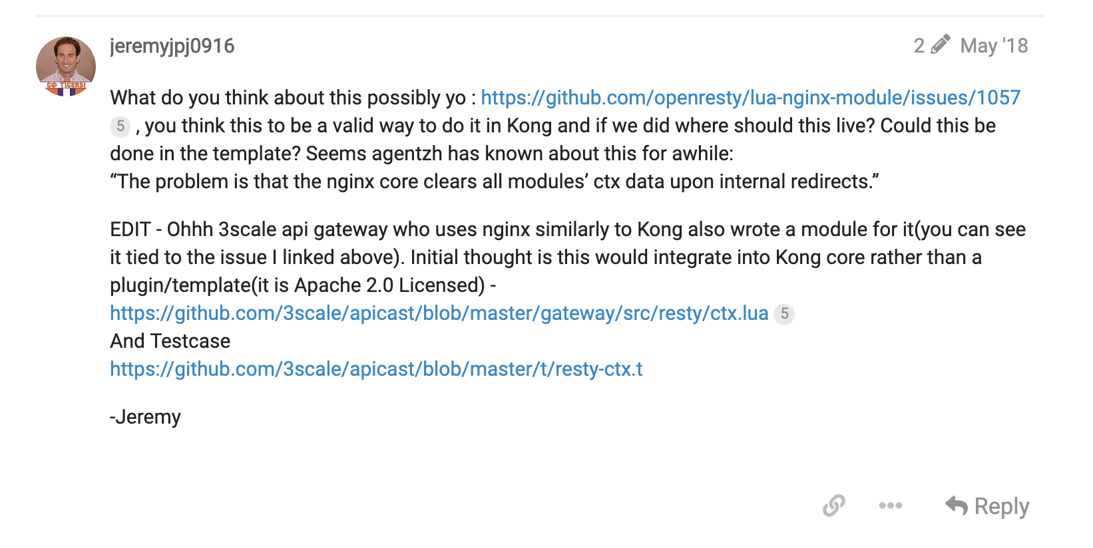
Notes:
R

Slide 32
Hmm…
Nginx’s error_page does an internal redirect which resets ngx.ctx… thus, no plugin will be run
We’ll take a look
We may have found something interesting in a similar Open-Source product.
Notes:
R
https://discuss.konghq.com/t/kong-http-log-plugin-errors/445
https://discuss.konghq.com/t/kong-http-log-plugin-errors/445/3

Slide 33
Hmm…
Nginx’s error_page does an internal redirect which resets ngx.ctx… thus, no plugin will be run
We’ll take a look
We may have found something interesting in a similar Open-Source product.
Looks like there’s a Library which may allow us to share the ngx.ctx between these subrequests. What do u think?
Notes:
R
https://discuss.konghq.com/t/kong-http-log-plugin-errors/445
https://discuss.konghq.com/t/kong-http-log-plugin-errors/445/3

Slide 34
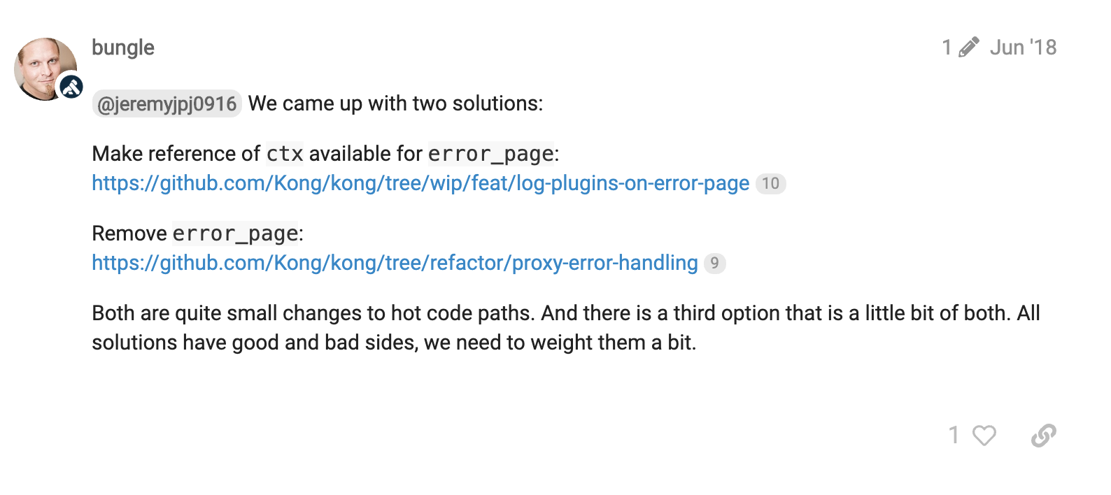
Notes:
R
https://discuss.konghq.com/t/kong-http-log-plugin-errors/445
https://discuss.konghq.com/t/kong-http-log-plugin-errors/445/3

Slide 35
We’ll take a look
We may have found something interesting in a similar Open-Source product.
Looks like there’s a Library which may allow us to share the ngx.ctx between these subrequests. What do u think?
We came up with some solutions. Each have positives and negatives
We need to weigh them internally, but all are small changes…
Notes:
R

Slide 36
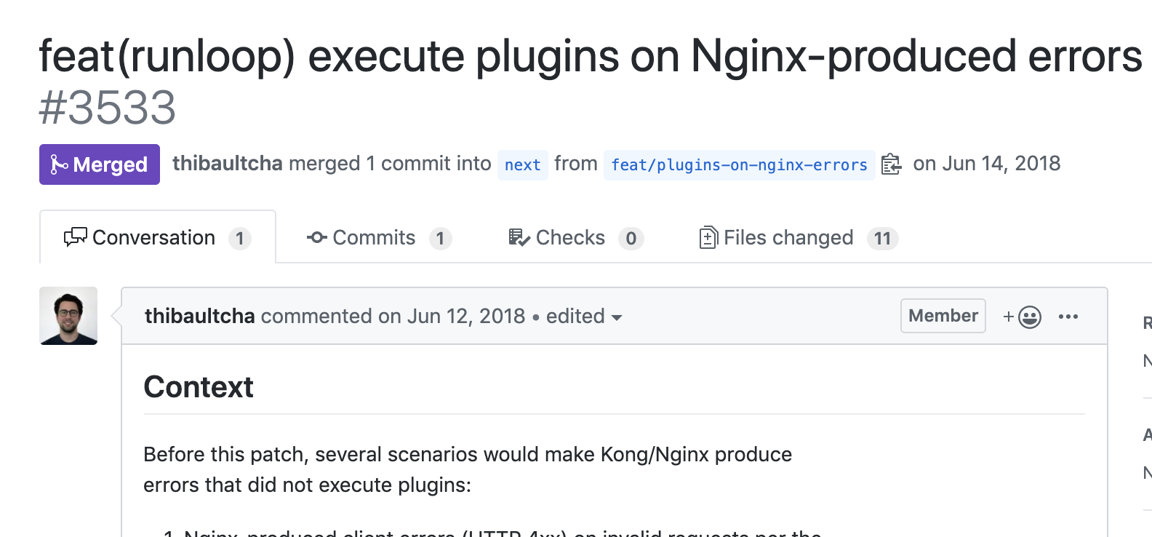
We’ll take a look
We may have found something interesting in a similar Open-Source product.
Looks like there’s a Library which may allow us to share the ngx.ctx between these subrequests. What do u think?
We came up with some solutions. Each have positives and negatives
We need to weigh them internally, but all are small changes…
Notes:
R

Slide 37
We’ll take a look
We may have found something interesting in a similar Open-Source product.
Looks like there’s a Library which may allow us to share the ngx.ctx between these subrequests. What do u think?
We came up with some solutions. Each have positives and negatives
We need to weigh them internally, but all are small changes…
Now closing this since #3533 has been merged - expect a 0.14.0rc1 in a few days. Thanks again!
Notes:
R

Slide 38
The Beginnings of Expertise
We had a problem
We investigated it
Issue came back to Kong
We engaged the community
We tried a possible solution from the community
No dice :P
We investigated it
We suggested a possible solution to the community
The community confirmed the solution
Notes:
R
So let’s recap what happened here
[speil]

Slide 39
The Beginnings of Expertise
We had a problem
We investigated it
Issue came back to Kong
We engaged the community
We tried a possible solution from the community
No dice :P
We investigated it
We suggested a possible solution to the community
The community confirmed the solution
Notes:
R
Now, there’s something a little weird here. This step appears twice.
So what changed between the first time we investigated the problem, and the second time we investigated the problem?
What changed was the problem, from our perspective. It went from “there’s something wrong with logging transport-layer errors in Kong” to “The problem is that the nginx core clears all modules’ ctx data upon internal redirects”.
Notice this fundamental difference between this interaction, and one with a vendor-provided expert.
This is a two way street – with knowledge flowing in both directions.
This is the virtuous cycle of open-source

Slide 40
Contributing Back
3
Embracing the virtuous cycle of Open Source
Notes:
S

Slide 41
Any issues with Kong today?
No, why?
We just started to receive some HTTP 431s during our testing… not sure why?
Looks like the ACL plugin includes a ever growing header containing all groups asociated to a consumer.
Notes:
J

Slide 42
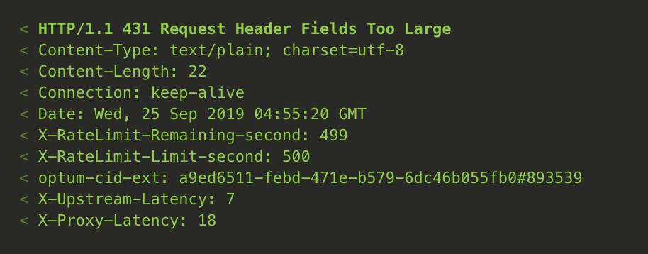
Any issues with Kong today?
No, why?
We just started to receive some HTTP 431s during our testing… not sure why?
Hmm.. Looks like HTTP Headers proxied are too big,
Let me look into which headers could be the culprit.
Looks like the ACL plugin includes a ever growing header containing all groups associated to a consumer.
Notes:
J

Slide 43
Any issues with Kong today?
No, why?
We just started to receive some HTTP 431s during our testing… not sure why?
Hmm.. Looks like HTTP Headers proxied are too big,
Let me look into which headers could be the culprit.
Looks like the ACL plugin includes a ever growing header containing all groups associated to a consumer.
Notes:
J

Slide 44
Any issues with Kong today?
No, why?
We just started to receive some HTTP 431s during our testing… not sure why?
Hmm.. Looks like HTTP Headers proxied are too big,
Let me look into which headers could be the culprit.
Looks like the ACL plugin includes a ever growing header containing all groups associated to a consumer.
Notes:
J

Slide 45
Any issues with Kong today?
No, why?
We just started to receive some HTTP 431s during our testing… not sure why?
Hmm.. Looks like HTTP Headers proxied are too big,
Let me look into which headers could be the culprit.
Looks like the ACL plugin includes a ever growing header containing all groups associated to a consumer.
Notes:
J

Slide 46
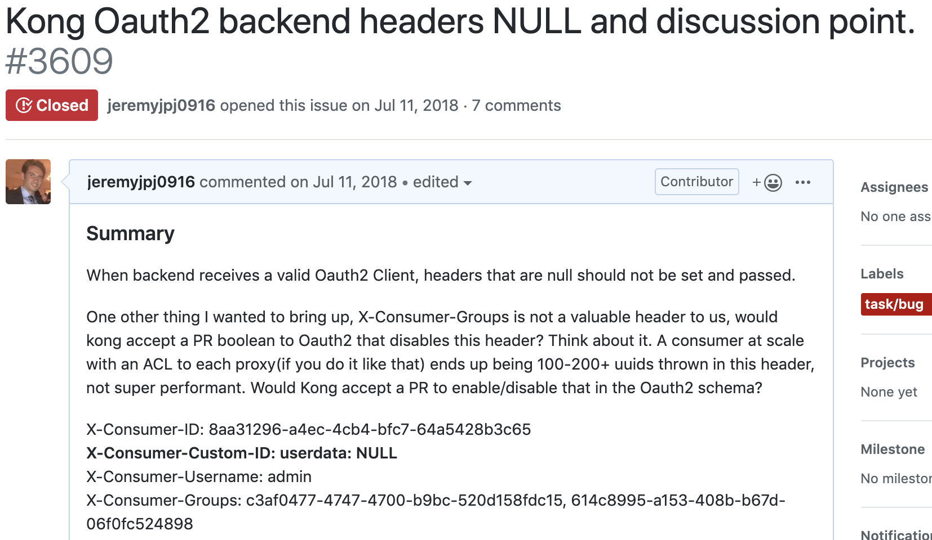
Notes:
J

Slide 47
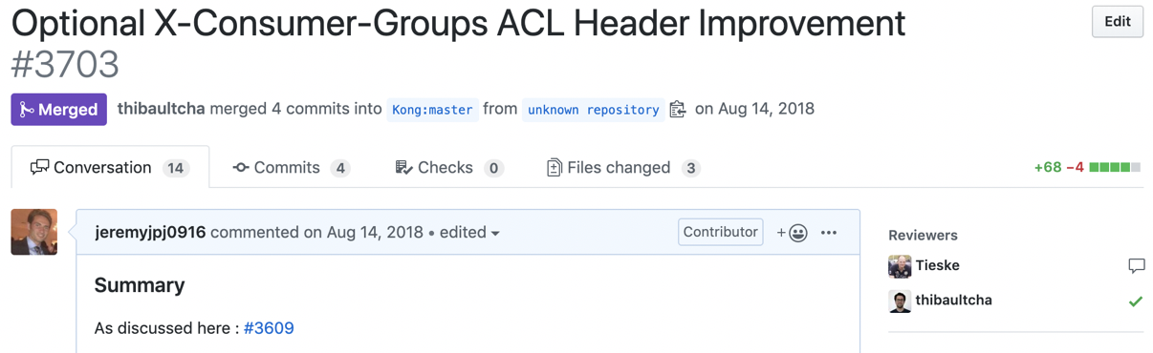
@jeremyjpj0916 I would give a + for such a PR on the ACL plugin.
I’ll try my hand at the code, thanks for the go ahead!
Notes:
J

Slide 48
@jeremyjpj0916 I would give a + for such a PR on the ACL plugin.
I’ll try my hand at the code, thanks for the go ahead!
Looks good!
Notes:
J

Slide 49
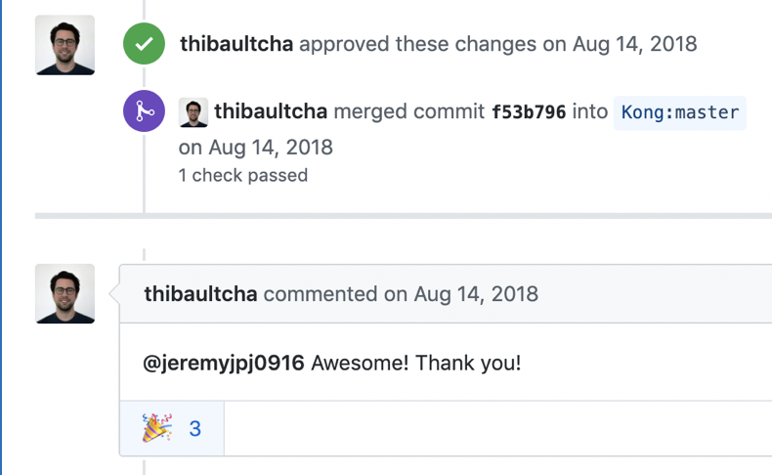
@jeremyjpj0916 I would give a + for such a PR on the ACL plugin.
I’ll try my hand at the code, thanks for the go ahead!
Looks good!
Notes:
J

Slide 50
Looks good!
We should also try setting a dummy-value in the cache, to reduce lua memory pressure
Try this
Notes:
J

Slide 51
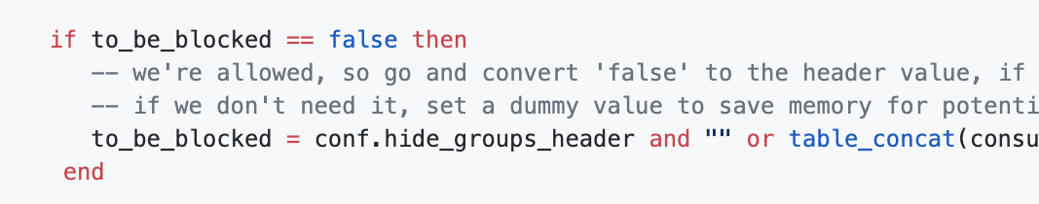
We should also try setting a dummy-value in the cache, to reduce lua memory pressure
Try this
Notes:
J

Slide 52
We should also try setting a dummy-value in the cache, to reduce lua memory pressure
Try this
Oh wow, great point I hadn’t considered that!
Let me iterate on this…
Notes:
J

Slide 53
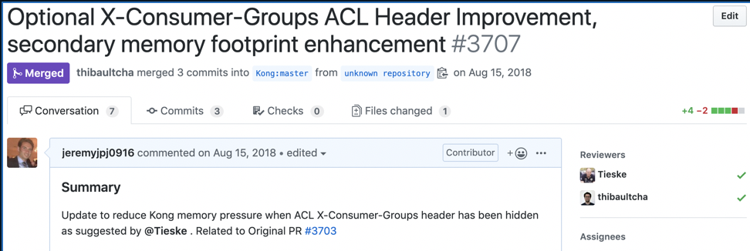
Notes:
J
Turnaround time? 2 PRs Merged Same Day Delivered.

Slide 54
Notes:
J
Turnaround time? 2 PRs Merged Same Day Delivered.

Slide 55
Offer a Product
4
Think of the technology and its integrations as a complete product
Notes:
S

Slide 56
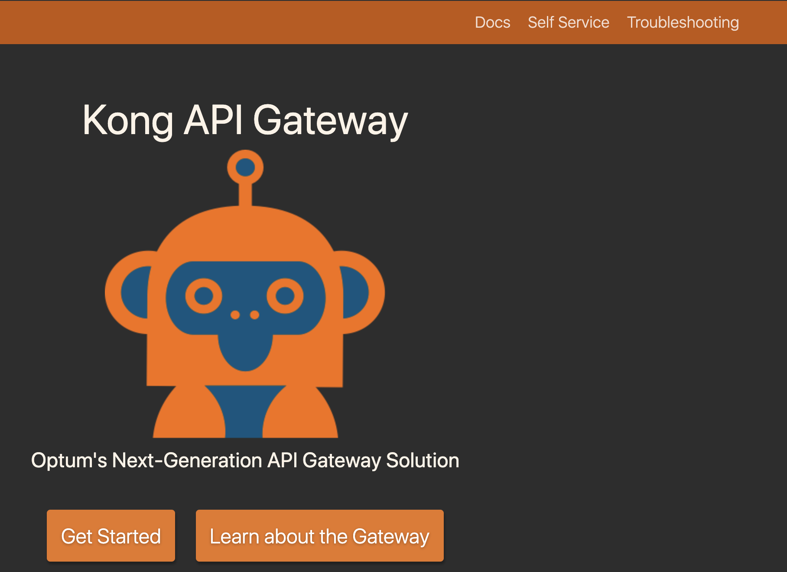
Docs First Approach
Lowers Operational Staffing Needs
Good documentation drastically reduces the need to meet & plan integrations, thus reducing the need for a large support team.
Good Engineering Culture
Providing environment-specific documentation provides your customers with the opportunity to innovate around your product, and enables DevOps!
Optum’s docs site contains 34 pages, covering everything
from supported security patterns, to self-service instructions.
Yes, we did give it an internal mascot ☺
Notes:
R

Slide 57
Operations Modernization
Email distribution list dialogs
Ticket work orders
Self-Service
-Github ops model
-Customer PRs to repo
-Github Webhook calls to Agent
-Agent integrates with Kong Admin API
Notes:
J
https://pixabay.com/illustrations/evolution-human-evolution-2780651/
https://pixabay.com/service/license/
Free for commercial use No attribution required

Slide 58
Kong Resource Abstractions
Namespace
Service level owner email
Team distribution list email
Access Control
Internal ID
Namespace resource
Proxy resource
Requirements
{
"kind” : "gateway-namespace",
"action” : "create",
"spec” : {
"id” : "xxxxxxxx-xxxx-xxxx-xxxx-xxxxxxxxxxxx",
"namespace” : "kong.summit.consumer",
"sloEmail” : "my.email@example.com",
"teamEmailDL” : "my.team.dl@example.com",
"accessControl” : "REDACTED",
"internalID” : "REDACTED"
},
"metadata” : {
"tags” : [
"Kong Summit 2019",
"Example Tag"
]
}
}
Components
Notes:
J
To answer that question, let’s skip forward to early 2018 and take a look at the first time Optum interacted with Kong (FIX WORDING)

Slide 59
Self-Service Flow
Customer reads docs
Customer PRs to Github
Self-Service Bot Processes PRs
Bot Feedback to Customers on PRs
Customer PRs adjustments if necessary
Feedback Loop
Github Webhook
Call to Kong Admin API
Notes:
J
To answer that question, let’s skip forward to early 2018 and take a look at the first time Optum interacted with Kong (FIX WORDING)

Slide 60
Results
5
Progress of our Ongoing Journey
Notes:
J

Slide 61
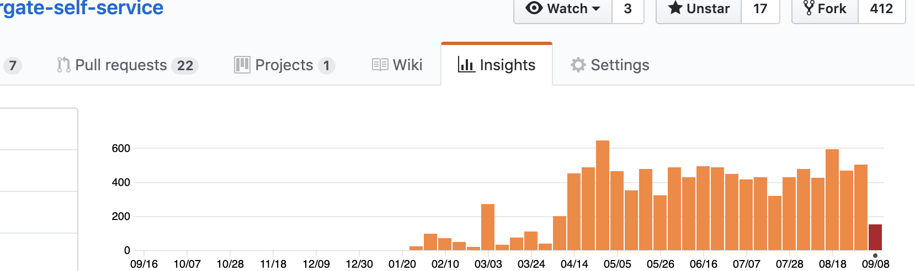
DevOps Self-Service Adoption
Features:
Metrics
GitHub-Native Revision History
Automated Reporting/Alerting Integration
300+ Unique Users
2000 Operations/mo
Notes:
J
Prometheus/Grafana automated Integrations

Slide 62

Sense of Our Scale
~1,900 APIs
~250 consumers
~375m API transactions
~7000 APIs
~1000 consumers
~4.2bn API transactions
*Monthly Active
Where we are:
Where we’re going:
Notes:
J
https://pixabay.com/illustrations/road-travel-journey-asphalt-4258554/
https://pixabay.com/service/license/
Free for commercial use No attribution required

Slide 63
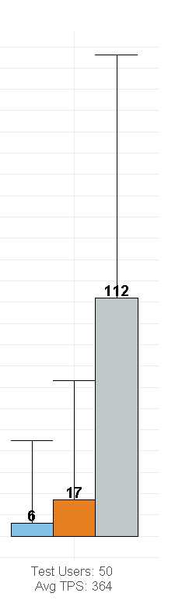
Comprehensive Improvements
>80% Reduction in Gateway Overhead compared with existing solution
>95% cost reduction (operational efficiency, licensing costs)
>85% reduction in operations staffing
2 Engineers supporting 300k Employees
Currently serving ~10% of all UHG API Traffic
Extensibility of Kong has provided the means to support many custom use cases within Optum
Kong’s superior performance
Notes:
S
To answer that question, let’s skip forward to early 2018 and take a look at the first time Optum interacted with Kong (FIX WORDING)

Slide 64
The Question
“How can we, as a large enterprise, have confidence in Open Source products?”
Notes:
R
Let’s return to our original question [say subtitle], and see if; based on these and other experiences, we can come up with an answer.

Slide 65
Our Answer
Set the Stage
Community Participation
Legal Approval
Revisit Existing Integrations
Promote Opensource Culture
Share knowledge
Solve Problems
Cultivate Internal Experts
Contribute Back
Enable innovation
Improve overall quality
Supportability
Direct community feedback
Community benefit
Notes:
R

Slide 66

Notes:
There is no Open Source without a Community.

